Slide 1
Research Question
What is the correlation between GDP per capita at the county level and the Covid 19 cases?
Notes:
Hello everyone, our research topic is to find whether a correlation exists between GDP per capita and Covid-19 cases at the county level . We aim to investigate the potential relationship between a county's economic prosperity, as measured by GDP per capita, and the number of Covid-19 cases in that county. We seek to explore whether counties with higher GDP per capita have better healthcare infrastructure, and more resources in general that prevent the Covid 19 spread or that they could be more likely to have higher numbers of cases due tp international travellers or larger population densities, which may increase the risk of transmission of the virus.

Slide 2
Research background and motivation
Previous research has suggested that socioeconomic factors such as income, education, and healthcare access may influence the risk and severity of Covid-19 infection.
This research seeks to build on this previous research by specifically examining the relationship between economic status, as measured by GDP per capita, and Covid-19 cases at the county level.
Notes:
Previous research has suggested that socioeconomic factors such as income, education, and healthcare access may influence the risk and severity of Covid-19 infection. These are some papers that deal with the impact of Covid 19 on the global economy. Our research seeks to specifically examine the relationship between economic status and Covid-19 cases at the county level. Understanding the potential relationship between them can have significant implications for public health policy. Additionally, this research may provide insights into the broader social and economic impacts of the pandemic on different regions and populations.
https://iopscience.iop.org/article/10.1088/1755-1315/546/3/032043/pdf
https://pubmed.ncbi.nlm.nih.gov/34069182/

Slide 3
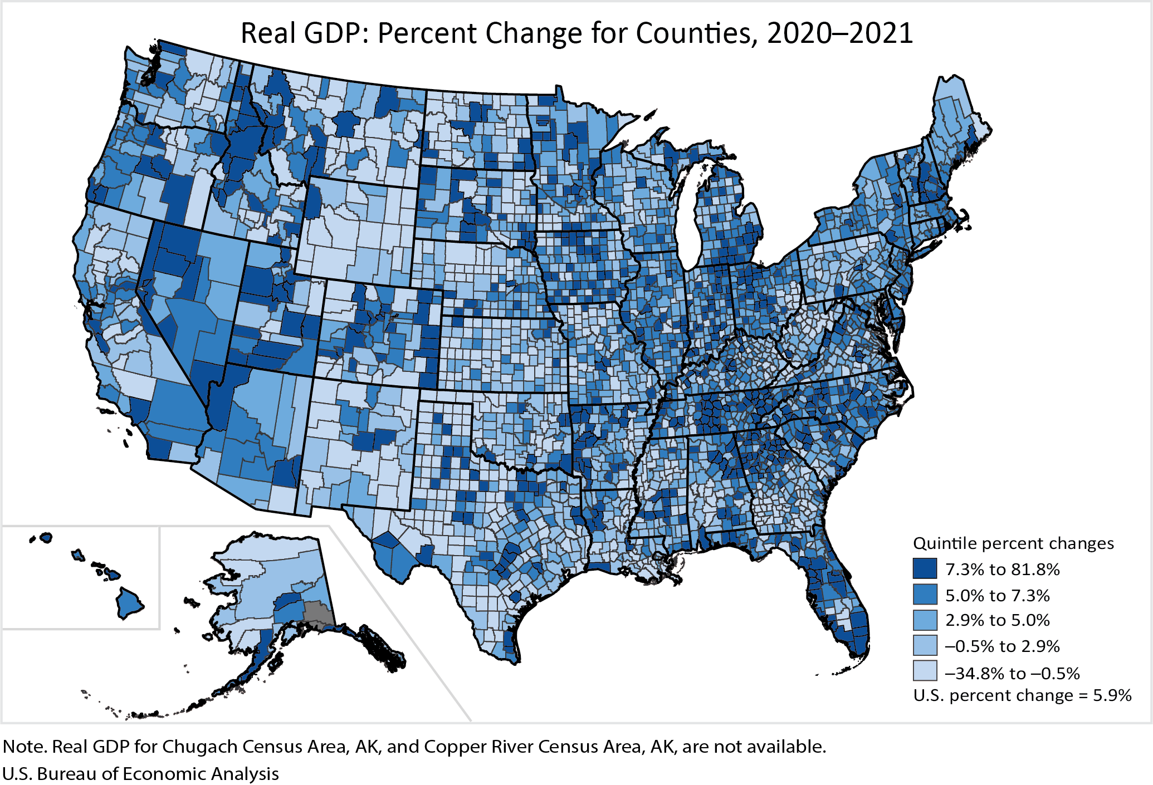
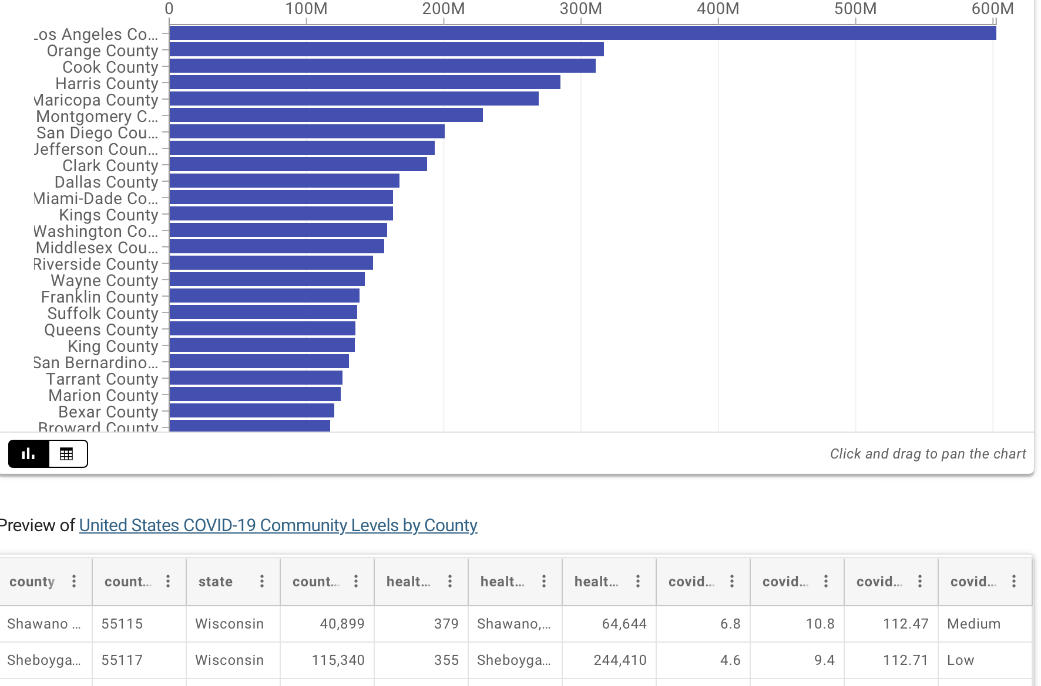
datasets
GDP at the county level
Covid-19 cases by county
Notes:
To answer our question, we are hoping to utilize two datasets. The first dataset being used is “GDP by County” for the year of 2021, sourced from BEA, an official website of the US government. The second dataset is “Covid-19 community levels by county” from CDC,

Slide 4
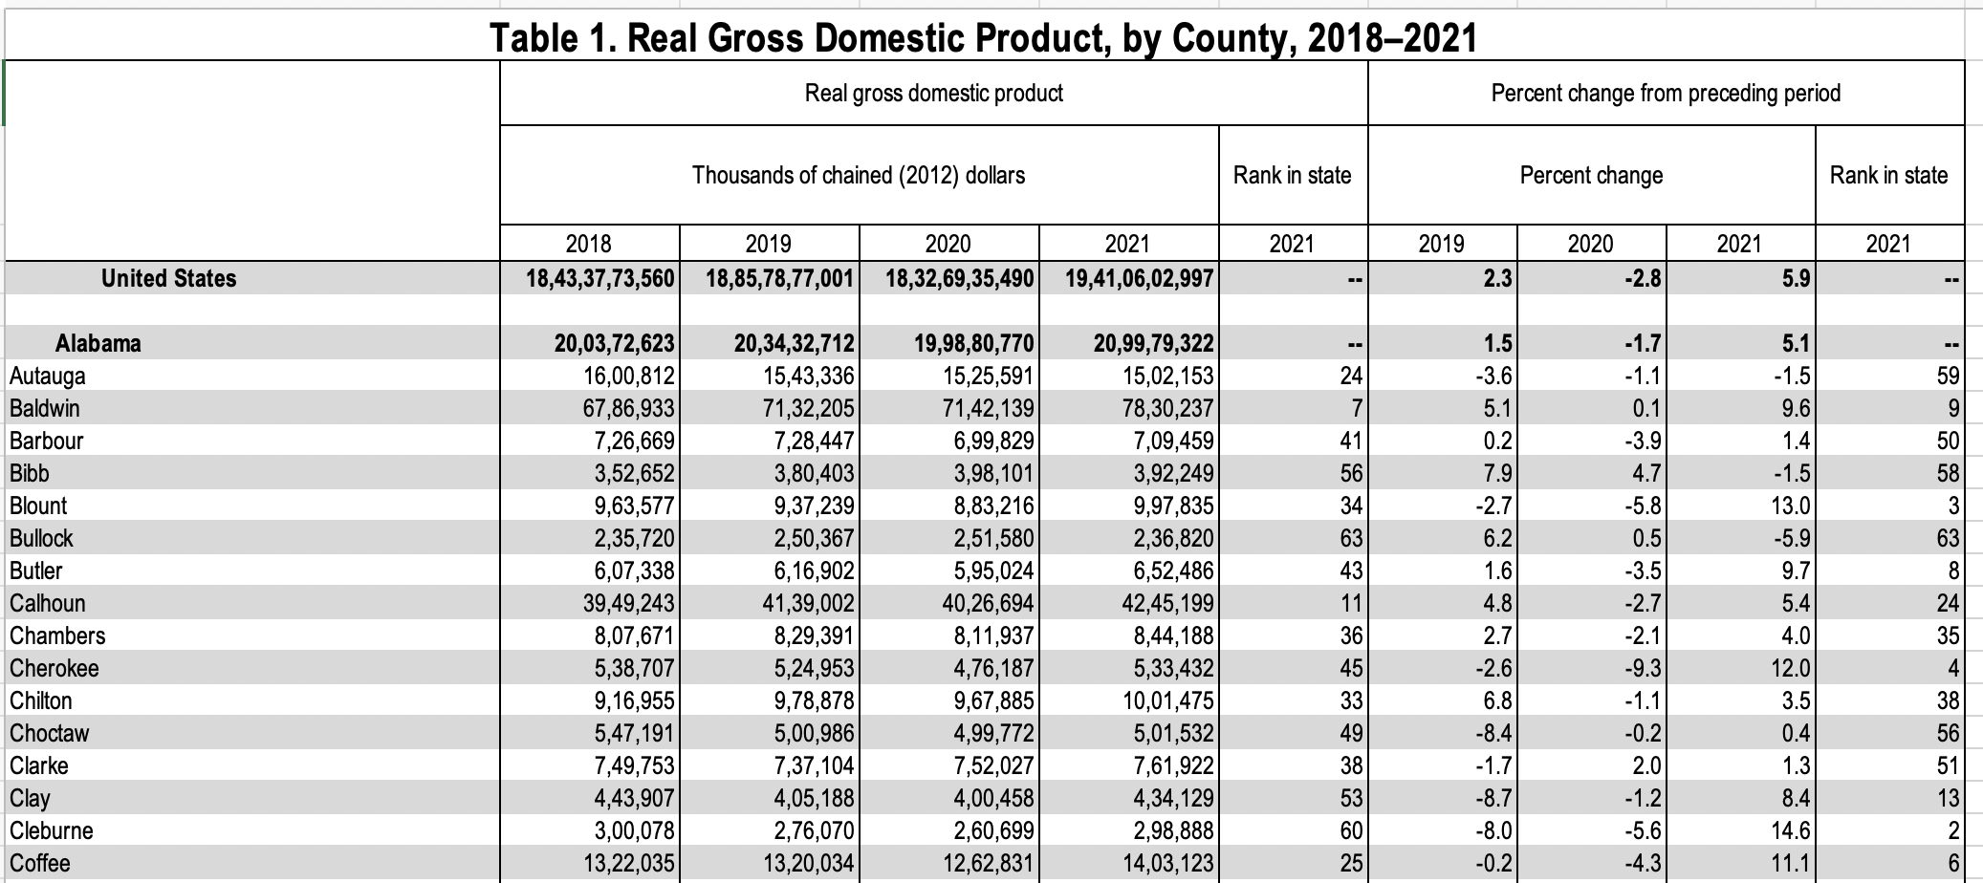
Dataset 1
Notes:
The first dataset is the GDP data of the counties of all the states in USA. It consists of the real GDP values by taking inflation into account. It also contains the percent changes from the preceding periods. The data spans from 2018 to 2021.

Slide 5
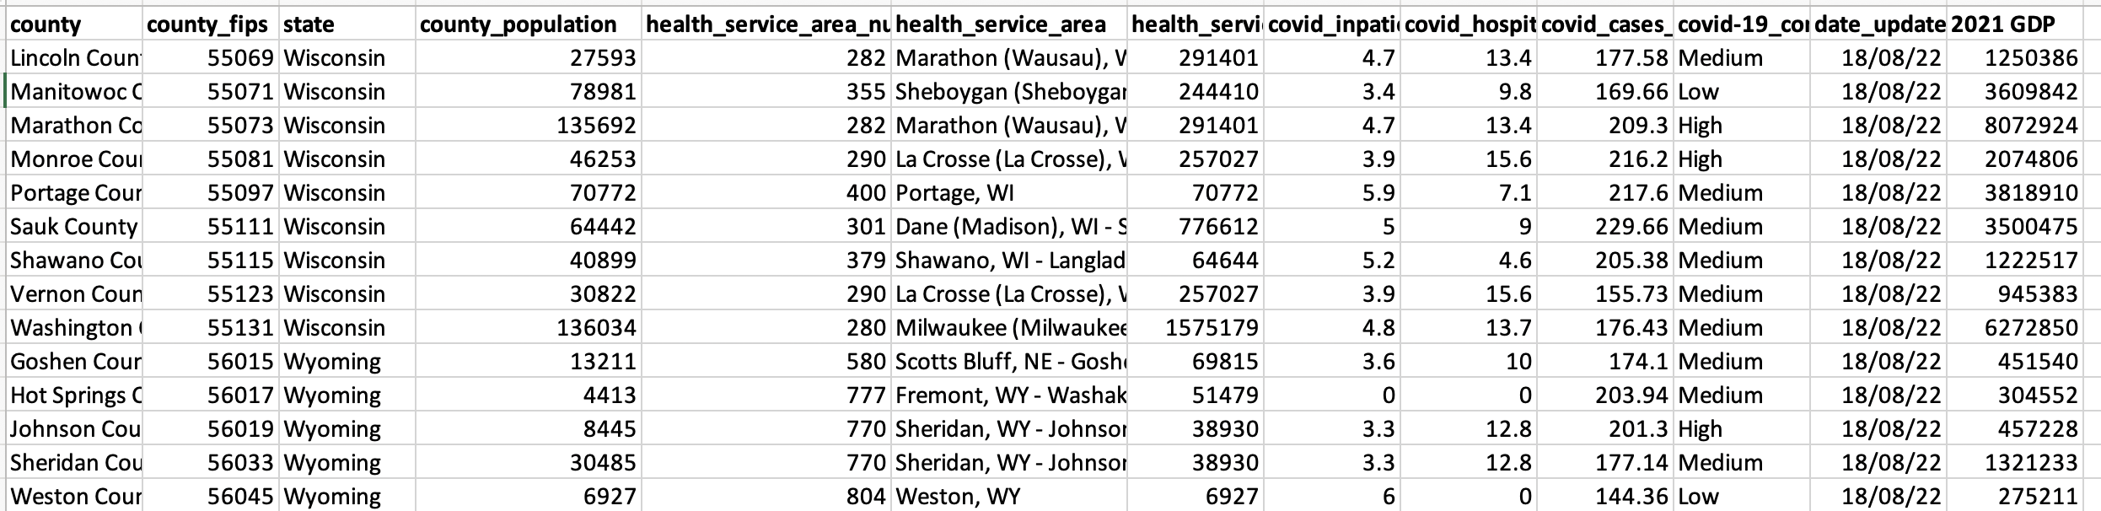
Dataset 11
Notes:
The second dataset contains the details of Covid – 19. It consists of all the county's Covid-19 Community Levels. In detail, it has the county information, the health service area information, percent of inpatient beds occupied by Covid-19 patients (7-day average), new Covid-19 admissions, new cases, Covid-19 community level (Low, Medium, High).
These two datasets have been merged on the county fips.

Slide 6
Data cleaning
Removing unnecessary columns that provide no insights
Checking for null values
Imputing using KNN imputer
Removing duplicate records
Correcting any format issues
Notes:
Coming to data cleaning, it is simply the process of identifying and correcting errors, inconsistencies, and inaccuracies in data. A few things we did to clean the dataset were to remove unnecessary columns such as id’s, that provide no insights, removing any duplicate records present, correcting any format issues, and checking for null values and imputing them using KNN imputer offered by sklearn.

Slide 7
knn
KNN is an algorithm that is useful for matching a point with its closest k neighbors in a multi-dimensional space
It can be used for data that are continuous, discrete, ordinal and categorical which makes it particularly useful for dealing with all kind of missing data
The assumption behind using KNN for missing values is that a point value can be approximated by the values of the points that are closest to it, based on other variables.
Pros:
Does not require creation of a predictive model for each attribute with missing data in the dataset
Cons:
Is a very time consuming process and it can be critical in data mining where large databases are being extracted
Notes:
K-NN imputation is a technique used to fill missing values in a dataset. The idea is to find K samples in the dataset that are close in the space. We then use those k samples to estimate the missing values using a statistical measure such as the mean, median, or mode of the values of those K neighbours.. It can be used for data that are continuous, discrete, ordinal and categorical which makes it particularly useful for dealing with all kind of missing data. A pro of KNN are that it doesn’t need a predictive model for imputation unlike regression imputation. However, it can be computationally expensive for large datasets, as it requires calculating the distance between the missing value and every other data point in the dataset.

Slide 8
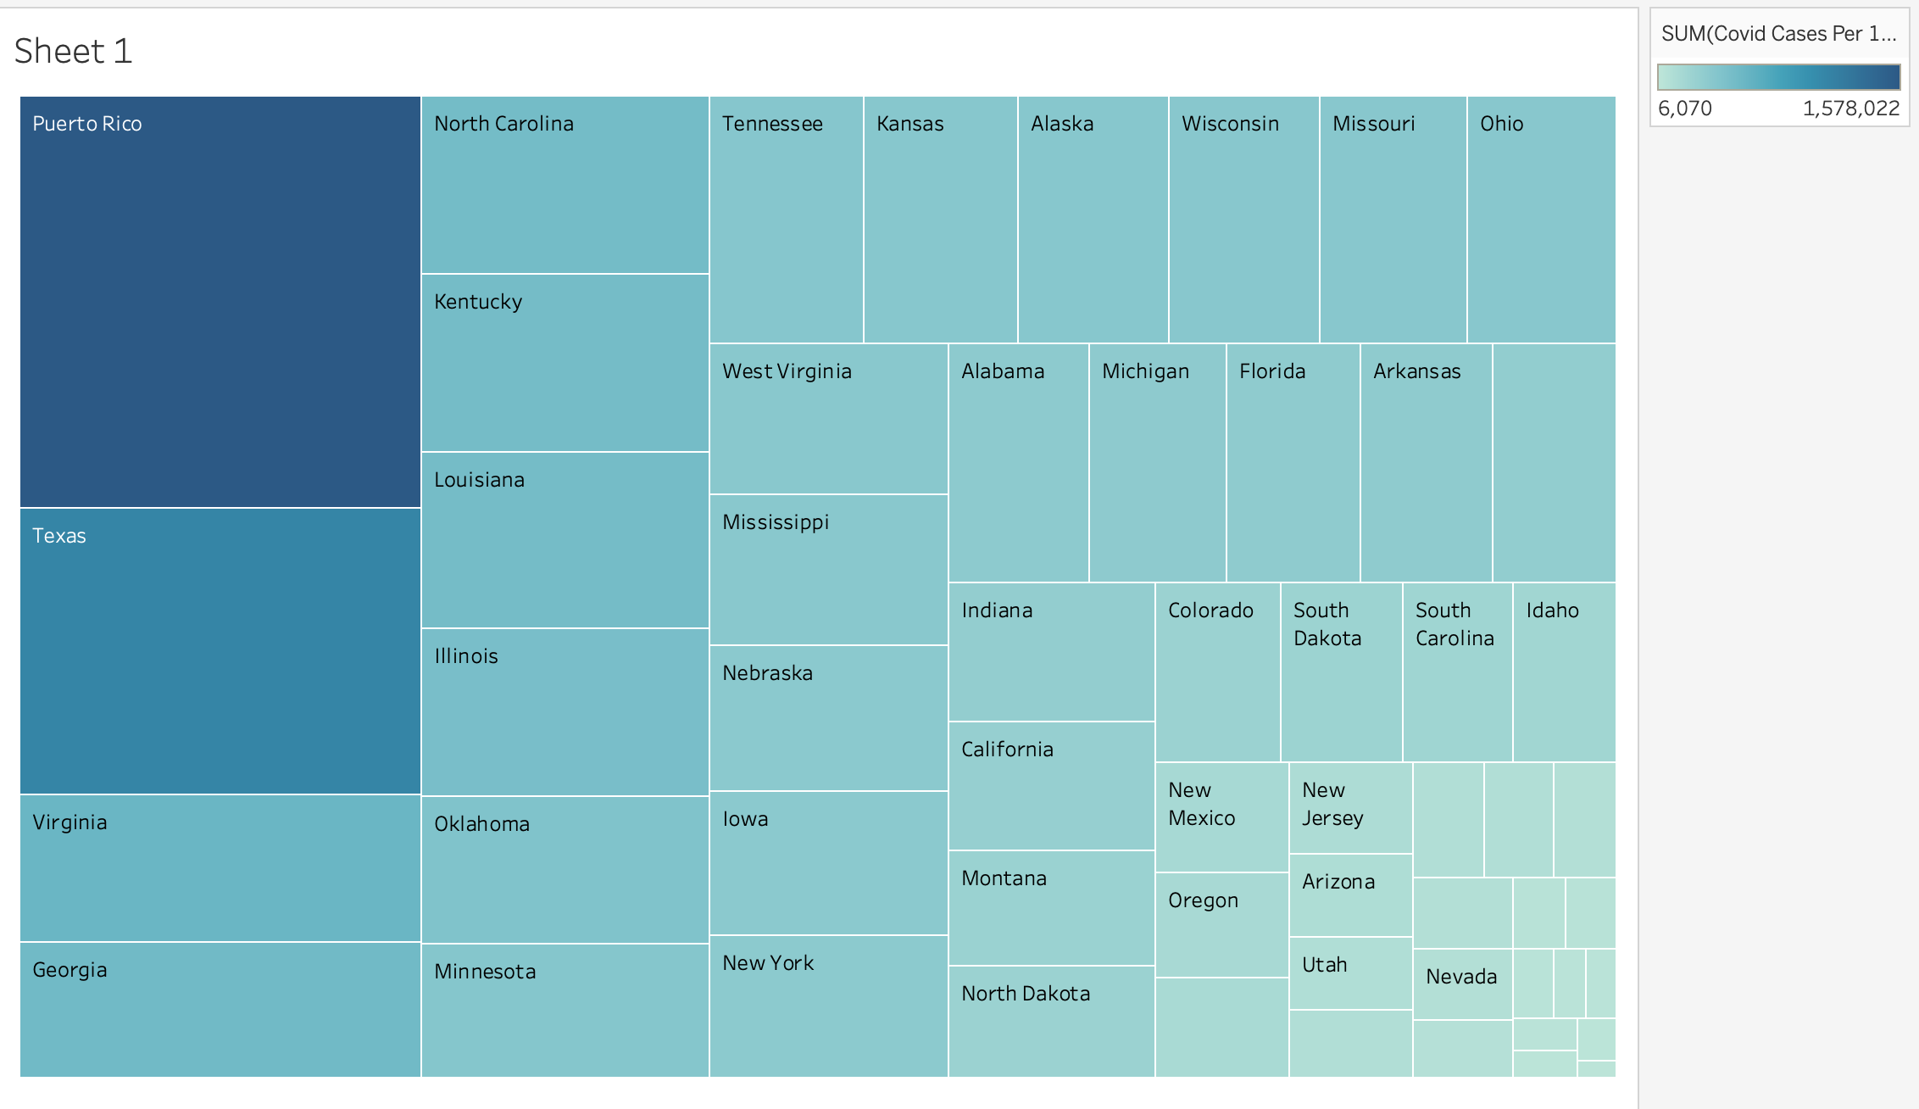
Covid cases heatmap by state
Plotting the Covid 19 cases grouped by state
Puerto Rico has the most number of cases, followed by Texas
Notes:
After cleaning the data, we performed some visualizations to get a sense of where to start. This heatmap shows the number of covid cases by the state. As seen, Puerto Rico has the most number of cases, followed by Texas. The states with the least number of cases are District of Columbia and the US Virgin Islands.

Slide 9
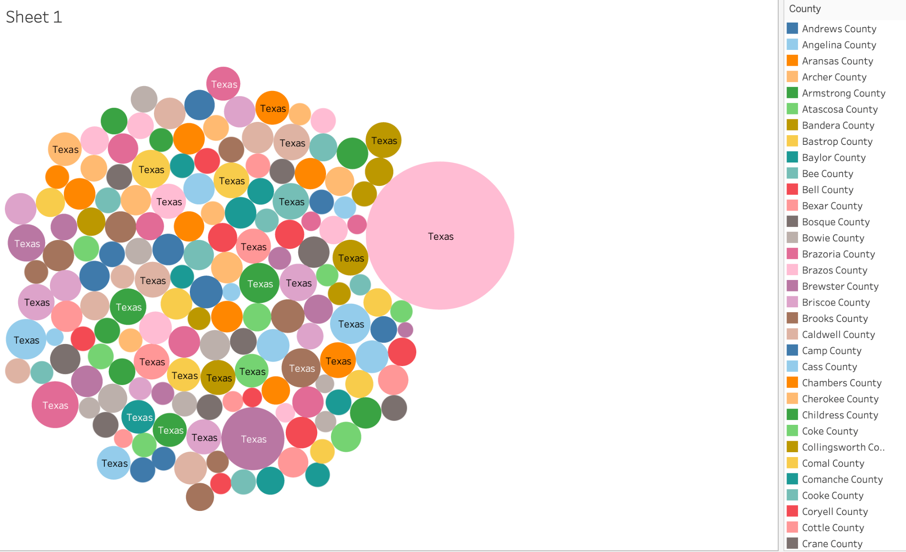
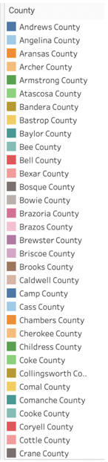
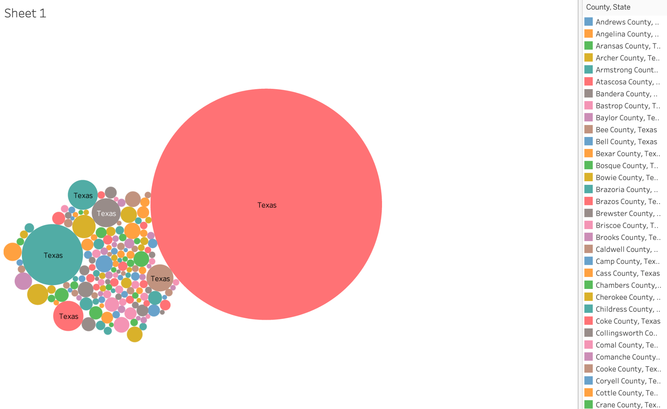
Covid cases vs gdp by county
Notes:
We then plotted the covid cases and GDP per capita at the county level for Texas as seen here. We chose Texas because it is the state with the highest number of counties. There are some counties with significantly more GDP per capita compared to the rest. For example, Loving County in Texas is one of the least populous counties in the US which could be the reason for the high GDP per capita. We can also see that the biggest circles in the left and right belong to Loving county, which could mean there is a correlation between the Covid cases and GDP per capita.

Slide 10
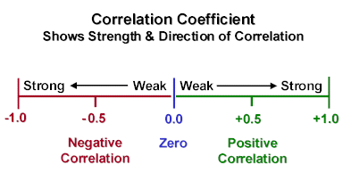
correlation
Not a modelling technique itself
The application of correlation analysis is to measure the degree of association between two sets of quantitative data.
Correlation makes no a priori assumption as to whether one variable is dependent on the other(s) and is not concerned with the relationship between variables; instead it gives an estimate as to the degree of association between the variables.
Types of Correlation
Positive or Negative Correlation
Simple, Multiple and Partial Correlation
Linear and Non linear Correlation
Notes:
Correlation analysis attempts to determine the degree of association between two quantitative variables. For eg. how are sales of product A correlated with sales of Product B. There are three types of correlation, Positive or Negative, Simple, Multiple and Partial, and Linear and Non linear correlations. An example could be increase in demand causes an increase in price (which is a positive correlation), and a decrease in supply might cause an increase in price (negative correlation). However its important to note that correlation does not mean causation.
(just for understanding:
Relation Between Height and Weight, Price and Demand is an example for Simple Correlation.
Relation between Income, Price and Demand is an example for Multiple Correlation.
Relationship between Rainfall and Crop after taking out consideration of the effect of other inputs like fertilizers, seeds and pesticides etc., then it is Partial Correlation.
)

Slide 11
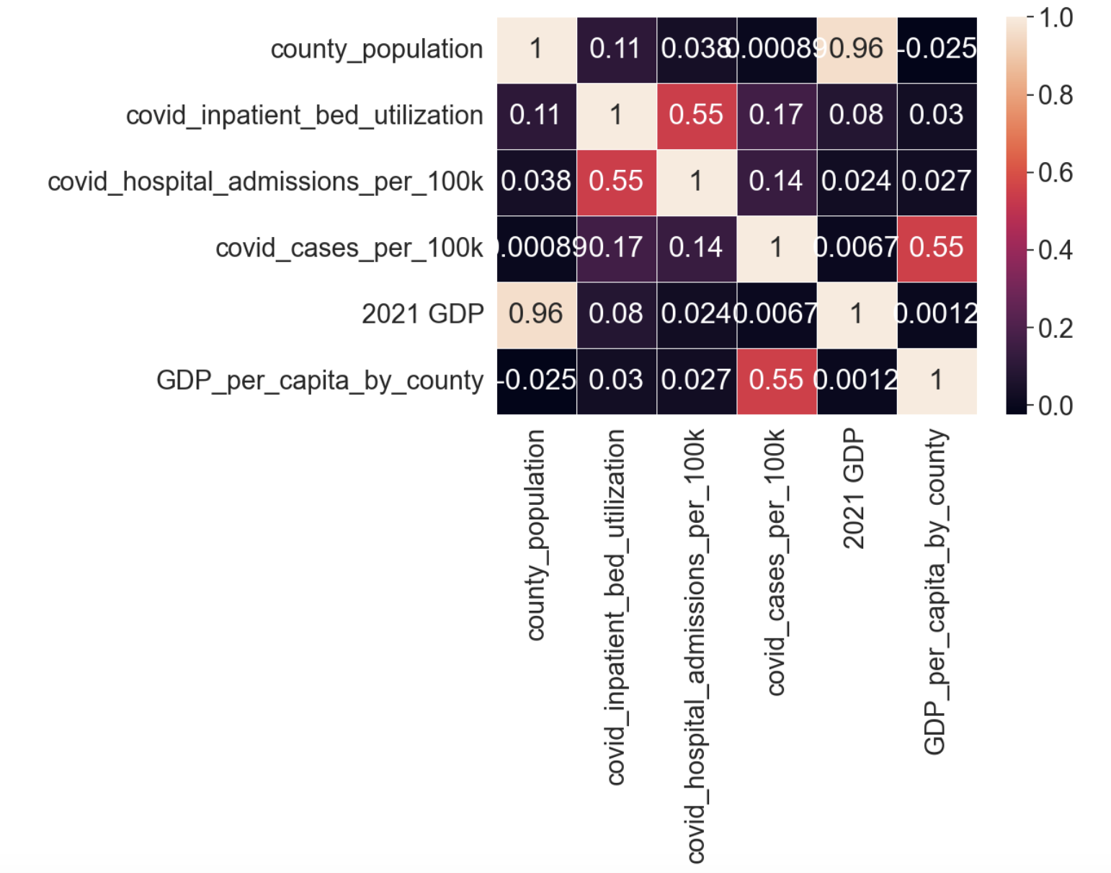
Data analysis: gdp per capita
Correlation heatmap of GDP per capita
Positive correlation between GDP and Covid cases
Notes:
We have plotted a correlation heatmap to see which features are correlated with each other. Checking for Texas, we see that there are positive correlations between covid_cases_per_100k and GDP_per_capita_by_county of 0.55, between covid inpatient bed utilization and covid hospital admissions of 0.55, and county GDP and population of 0.96. Here, Inpatient bed utilization refers to the percentage of hospital beds that are occupied by patients who need an overnight stay in the hospital. Hospital admissions, on the other hand, refer to the number of patients admitted to the hospital over a given period of time. These results imply that there could be an interdependence between the GDP per count and the number of covid cases.

Slide 12
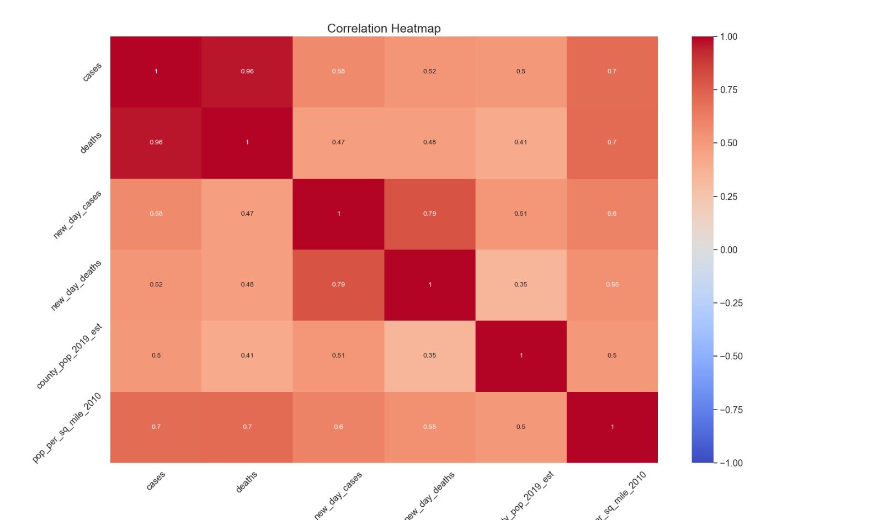
Data analysis: population density
Correlation heatmap of population density
Positive correlation between GDP and Covid cases
Notes:
To gain more insights, we also plotted a correlation heatmap of the population density and covid. A correlation of 0.7 between population density and Covid cases means that there is a strong positive relationship between these two variables. This indicates that as population density increases, the number of Covid cases also tends to increase. However, it is important to note that correlation does not necessarily imply causation.

Slide 13
Linear regression
A supervised learning technique that provides a continuous variable as output
Output: continuous variable
Input: numeric data
Convert categorical to numeric / binary first
For simple linear regression, there are several assumptions that must be met in order for the model to be valid
Linear relationship between input and output variable
Validate via scatter plot
High correlation
Validate via correlation matrix
Homoscedasticity (constant variance) of the errors
Notes:
Linear regression is used to model the relationship between a dependent variable and one or more independent variables. It is a type of supervised learning algorithm, where the predicted output has to be a continuous variable and the input has to be numeric. If its not, there are a few encoding techniques that can be applied to categorical variables to convert them to numeric. There are various conditions that must be met for the model to be valid, such as no multicollinearity and spread of the residuals (meaning the difference between the predicted and actual values of the dependent variable) should be consistent across all values of the independent variable. The model can be visualized by plotting a scatterplot or a correlation matrix, and validated using RMSE and R squared. RMSE(Root mean square error) measures the difference between the predicted values and the actual values of the dependent variable, in terms of the standard deviation of the errors. R squared measures the proportion of variance in the dependent variable that can be explained by the independent variable(s) in the model. A higher R-squared value indicates a stronger relationship between the dependent and independent variables, and therefore a better fit of the model to the data.

Slide 14
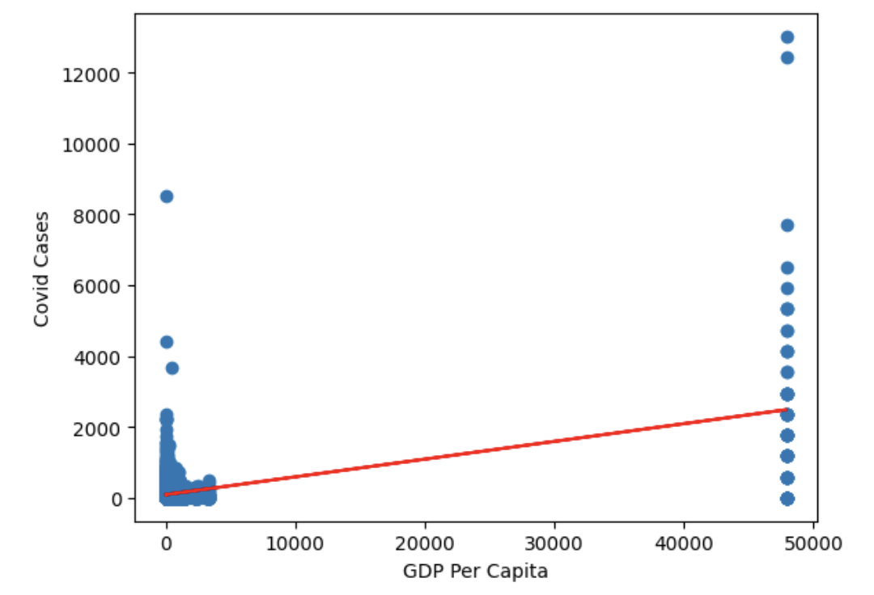
Linear regression: gdp per capita
R-squared: 0.3062
RMSE: 227.05
Notes:
After plotting the linear regression between GDP per capita and covid cases at the county level, we get the following results.

Slide 15
Model evaluation results
An RMSE of 227 for predicting COVID cases given GDP suggests that, on average, the model's predictions are off by 227 units (whatever units are used for the response variable, whether it is COVID cases or something related to it) from the actual COVID cases.
An R-squared value of 0.306 for predicting COVID cases given GDP suggests that around 30.6% of the variability in COVID cases can be explained by GDP.
Notes:
An RMSE of 227 suggests that, on average, the model's predictions are off by 227 from the actual COVID cases. This suggests that the model has some level of error, and there may be other factors besides GDP that are also influencing the number of COVID cases. An R-squared value of 0.306 suggests that around 30.6% of the variability in COVID cases can be explained by GDP. This suggests that there is a moderately strong relationship between GDP and COVID cases, but there are also other factors that are not included in the model that could be influencing the number of cases. We can say that the model based on GDP has some predictive power, but there is still a lot of unexplained variation in the data.

Slide 16
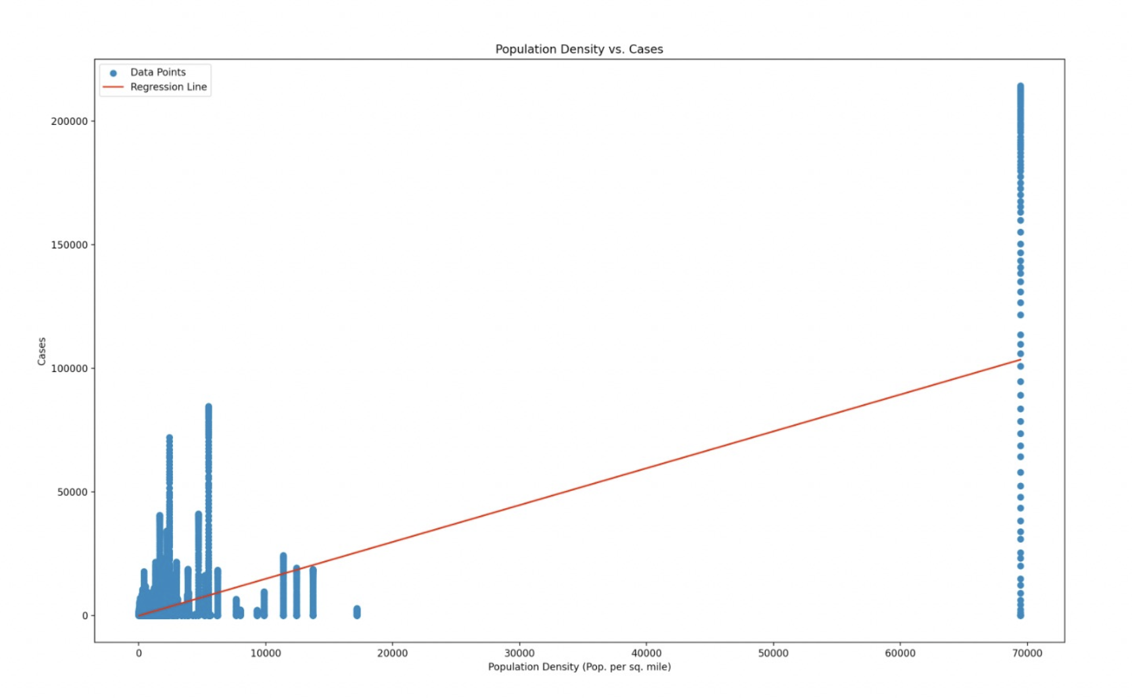
Linear regression: population density
R-squared: 0.486
RMSE: 2636
Notes:
As GDP seems to not be the sole predictor of COVID cases, we decided to look at the population density as well. When checking the regression between population density (given by population per square mile) and covid cases, we get the above scatterplot. An R-squared value of 0.486 between COVID cases and population density means that approximately 48.6% of the variability in COVID cases can be explained by population density. This indicates that population density is a moderately strong predictor of COVID cases.

Slide 17
conclusion
We can conclude that both GDP and population density are positively associated with Covid cases, but the strength of the association is different.
A correlation of 0.7 between population density and Covid cases indicates a stronger relationship than the correlation of 0.5 between GDP and Covid cases. This suggests that population density may be a stronger predictor of Covid cases than GDP.
However, it's important to note that correlation does not necessarily imply causation. While there may be a strong relationship between these variables and Covid cases, other factors may also be involved.
Notes:
We can conclude that both GDP and population density are positively associated with Covid cases, but the strength of the association is different.
A correlation of 0.7 between population density and Covid cases indicates a stronger relationship than the correlation of 0.5 between GDP and Covid cases. This suggests that population density may be a stronger predictor of Covid cases than GDP.
However, it's important to note that correlation does not necessarily imply causation. While there may be a strong relationship between these variables and Covid cases, other factors may also be involved.

Slide 18
Future analysis
Developing and testing hypotheses about the relationship between these variables can help to further refine our understanding of their impact on Covid cases. For example, hypotheses could be developed about the relative impact of GDP versus population density on Covid cases, and these hypotheses could be tested using statistical tests such as t-tests or ANOVA.
Conducting multivariate analysis can help to determine the independent contributions of GDP and population density to the prediction of Covid cases, while controlling for other relevant variables. This can involve fitting a multiple regression model to the data to identify the unique impact of each predictor variable on Covid cases.
Notes:
In the future we plan to perform hypothesis testing and multivariate analysis.
Developing and testing hypotheses about the relationship between these variables can help to further refine our understanding of their impact on Covid cases. For example, hypotheses could be developed about the relative impact of GDP versus population density on Covid cases, and these hypotheses could be tested using statistical tests such as t-tests or ANOVA.
Conducting multivariate analysis can help to determine the independent contributions of GDP and population density to the prediction of Covid cases, while controlling for other relevant variables. This can involve fitting a multiple regression model to the data to identify the unique impact of each predictor variable on Covid cases.

